Slide 1


<Name>
<Date>

Slide 2
Executive Summary
Introduction
Methodology
Results
Conclusion
Appendix
Outline

Slide 3
SUMMARY OF METHODOLOGIES
Executive Summary
Data Collection through SpaceX API
Data Collection with Web Scraping
Data Wrangling
EDA with Visualization
EDA with SQL
Building an Interactive Map with Folium
Machine Learning Prediction and Analysis
SUMMARY OF ALL RESULTS
Preliminary analysis based on EDA
Interactive Analytics with screenshots
Machine Learning Predictive analysis results

Slide 4
PROJECT BACKGROUND AND CONTEXT
SpaceX has transformed the space industry with its Falcon 9 rocket by prioritizing reusability to reduce launch costs. According to their website, a Falcon 9 launch costs around $62 million, whereas other providers, including NASA, can charge over $165 million for similar launches. One of the key factors in SpaceX's cost-saving approach is their ability to successfully land and reuse the first stage of the Falcon 9. If a new competitor, such as SpaceY, wants to challenge SpaceX in the market, it is essential to understand the success rate of first-stage landings. This project aims to analyze the available data and use machine learning to predict the success of the Falcon 9’s first-stage landing. Such insights can be invaluable for competitors looking to effectively bid against SpaceX.
Introduction
MATTERS TO EXAMINE
What factors determine if Falcon 9 will land successfully?
How does the success rate of the Falcon 9 landings compare to other rockets?
What features in the data are most influential in predicting successful lands?

Slide 5

Section 1

Slide 6
Executive Summary
Data collection methodology:
Describe how data was collected
Perform data wrangling
Describe how data was processed
Perform exploratory data analysis (EDA) using visualization and SQL
Perform interactive visual analytics using Folium and Plotly Dash
Perform predictive analysis using classification models
How to build, tune, evaluate classification models
DATA COLLECTION METHODOLOGY
Using SpaceX Rest API
Web Scrapping from Wikipedia
Methodology
PERFORM DATA WRANGLING
Data was cleaned and transformed using one-hot encoding for machine learning
PERFORM EDA USING VISUALIZATION AND SQL
Data was queried with SQL and various plots were used to show patterns in the data
PERFORM INTERACTIVE VISUAL ANALYTICS USING FOLIUM AND PLOTLY DASH
Folium was used along with Dash to build interactive maps and a dashboard
PERFORM PREDICTIVE ANALYSIS USING CLASSIFICTION MODELS
Different ML algorithms were used to find the most accurate results on the data.

Slide 7
Data Collection
For data collection, I employed the following methods:
Request and parse the SpaceX launch data using the GET request via the SpaceX Rest API
Web scrape SpaceX’s Wikipedia page for launch data using Beautiful Soup. The objective was to get the necessary tables needed from it.

Slide 8
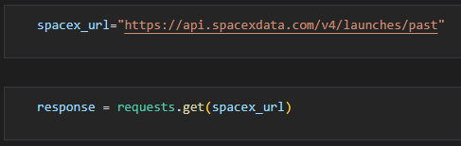
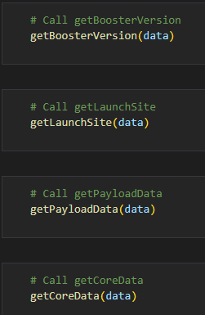
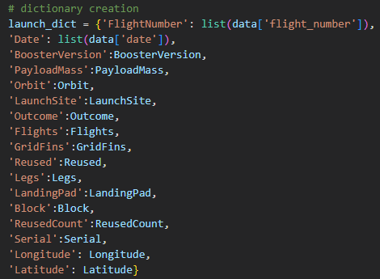
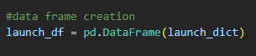
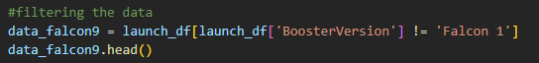
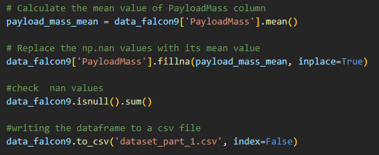
Executive Summary
Data collection methodology:
Describe how data was collected
Perform data wrangling
Describe how data was processed
Perform exploratory data analysis (EDA) using visualization and SQL
Perform interactive visual analytics using Folium and Plotly Dash
Perform predictive analysis using classification models
How to build, tune, evaluate classification models
Data Collection – SpaceX API
I used the get request to SpaceX to collect data and did some light data wrangling
Save data out to CSV file
Link to the completed notebook https://github.com/byvfx/ibm_ds_capstone/blob/main/jupyter-labs-spacex-data-collection-api.ipynb

Slide 9
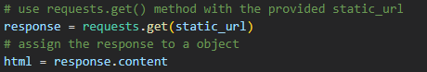
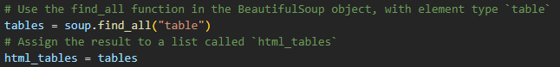
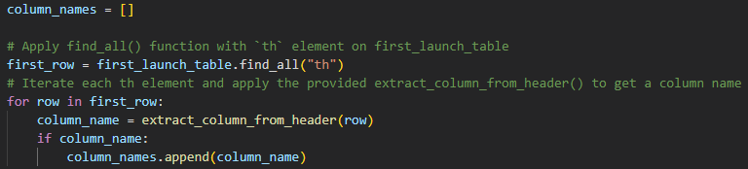
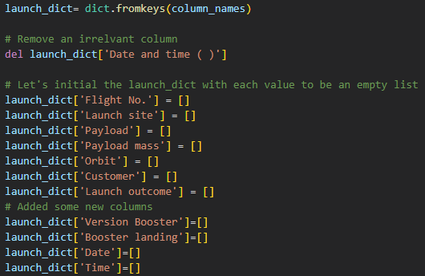
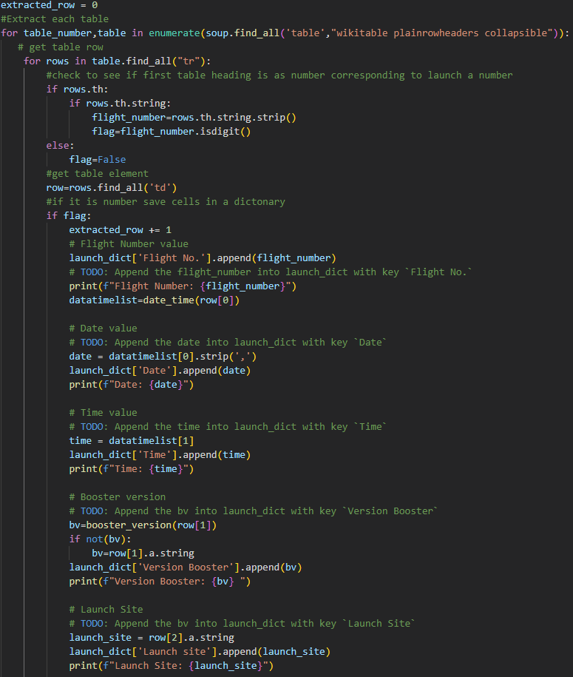
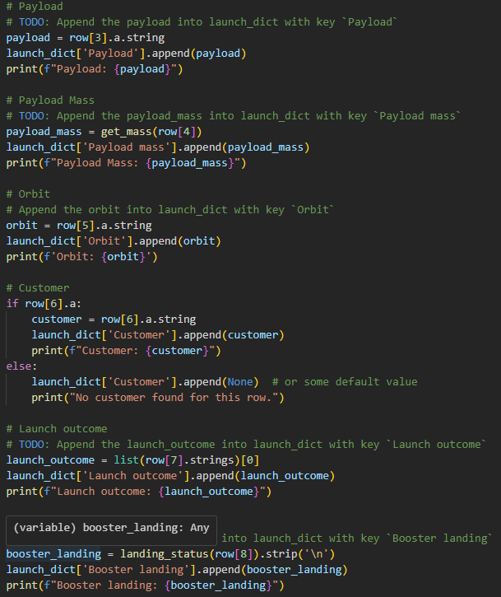
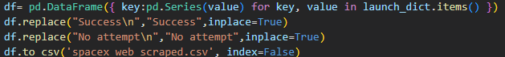
Executive Summary
Data collection methodology:
Describe how data was collected
Perform data wrangling
Describe how data was processed
Perform exploratory data analysis (EDA) using visualization and SQL
Perform interactive visual analytics using Folium and Plotly Dash
Perform predictive analysis using classification models
How to build, tune, evaluate classification models
Data Collection – Scraping
I used Beautiful Soup to scrape the data from Wikipedia
Extracted all column/variable names from the HTML table header
Created a data frame by parsing the launch HTML tables
Save data to a CSV file
Link to the completed notebook https://github.com/byvfx/ibm_ds_capstone/blob/main/jupyter-labs-webscraping.ipynb

Slide 10
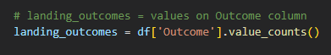
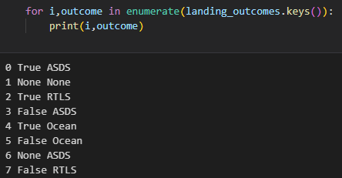
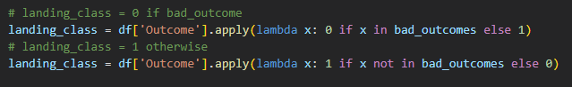
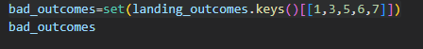
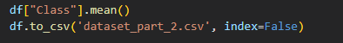
Executive Summary
Data collection methodology:
Describe how data was collected
Perform data wrangling
Describe how data was processed
Perform exploratory data analysis (EDA) using visualization and SQL
Perform interactive visual analytics using Folium and Plotly Dash
Perform predictive analysis using classification models
How to build, tune, evaluate classification models
Data Wrangling
With the data from the SpaceX API I needed to do the following:
Calculate the number of launches on each site
Calculate the number and occurrence of each orbit
Calculate the number and occurrence of mission outcome of the orbits
Create a landing outcome label from the ‘Outcome’ column, classifying it as successful or failure.
Save data to a CSV file
Link to the completed notebook https://github.com/byvfx/ibm_ds_capstone/blob/main/labs-jupyter-spacex-Data%20wrangling.ipynb

Slide 11
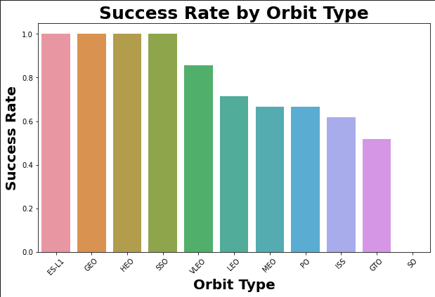
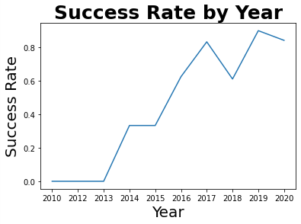
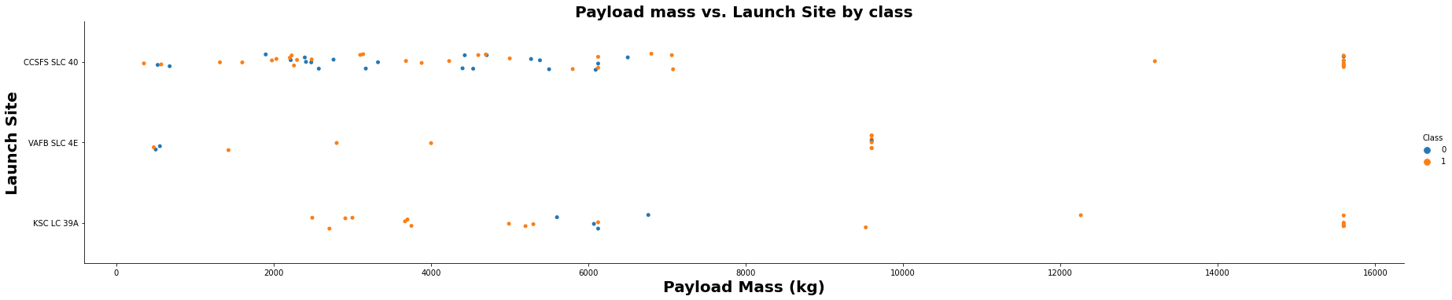
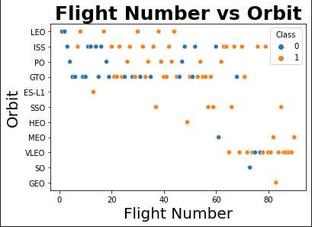
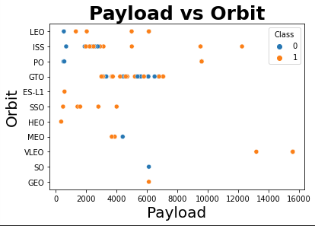
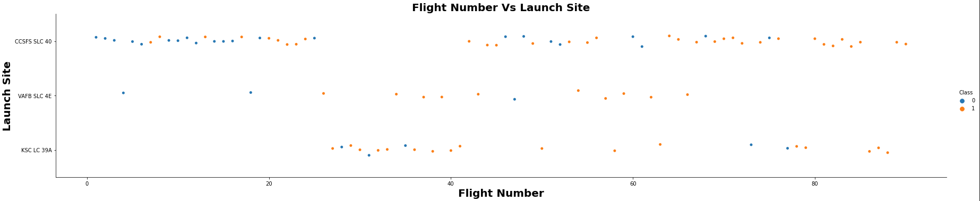
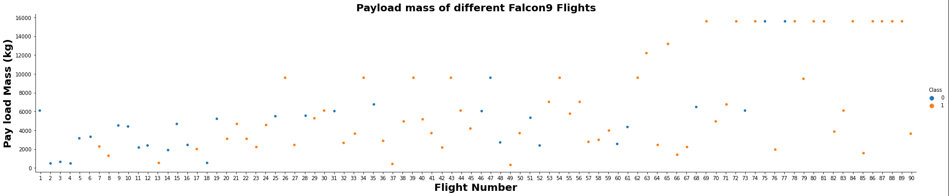
Executive Summary
Data collection methodology:
Describe how data was collected
Perform data wrangling
Describe how data was processed
Perform exploratory data analysis (EDA) using visualization and SQL
Perform interactive visual analytics using Folium and Plotly Dash
Perform predictive analysis using classification models
How to build, tune, evaluate classification models
EDA with Data Visualization
I explored the data relationship between flight number, launch site, payload and success rate of each orbit type, and the launch success yearly trend.
Link to the completed notebook https://github.com/byvfx/ibm_ds_capstone/blob/main/labs-jupyter-spacex-Data%20wrangling.ipynb

Slide 12

EDA with SQL
Using bullet point format, summarize the SQL queries you performed
Add the GitHub URL of your completed EDA with SQL notebook, as an external reference and peer-review purpose

Slide 13
Build an Interactive Map with Folium
Summarize what map objects such as markers, circles, lines, etc. you created and added to a folium map
Explain why you added those objects
Add the GitHub URL of your completed interactive map with Folium map, as an external reference and peer-review purpose

Slide 14
Build a Dashboard with Plotly Dash
Summarize what plots/graphs and interactions you have added to a dashboard
Explain why you added those plots and interactions
Add the GitHub URL of your completed Plotly Dash lab, as an external reference and peer-review purpose

Slide 15
Predictive Analysis (Classification)
Summarize how you built, evaluated, improved, and found the best performing classification model
You need present your model development process using key phrases and flowchart
Add the GitHub URL of your completed predictive analysis lab, as an external reference and peer-review purpose

Slide 16
Results
Exploratory data analysis results
Interactive analytics demo in screenshots
Predictive analysis results

Slide 17

Section 2

Slide 18
Flight Number vs. Launch Site
Show a scatter plot of Flight Number vs. Launch Site
Show the screenshot of the scatter plot with explanations

Slide 19
Payload vs. Launch Site
Show a scatter plot of Payload vs. Launch Site
Show the screenshot of the scatter plot with explanations

Slide 20
Success Rate vs. Orbit Type
Show a bar chart for the success rate of each orbit type
Show the screenshot of the scatter plot with explanations

Slide 21
Flight Number vs. Orbit Type
Show a scatter point of Flight number vs. Orbit type
Show the screenshot of the scatter plot with explanations

Slide 22
Payload vs. Orbit Type
Show a scatter point of payload vs. orbit type
Show the screenshot of the scatter plot with explanations

Slide 23
Launch Success Yearly Trend
Show a line chart of yearly average success rate
Show the screenshot of the scatter plot with explanations

Slide 24
All Launch Site Names
Find the names of the unique launch sites
Present your query result with a short explanation here

Slide 25
Launch Site Names Begin with 'CCA'
Find 5 records where launch sites begin with `CCA`
Present your query result with a short explanation here

Slide 26
Total Payload Mass
Calculate the total payload carried by boosters from NASA
Present your query result with a short explanation here

Slide 27
Average Payload Mass by F9 v1.1
Calculate the average payload mass carried by booster version F9 v1.1
Present your query result with a short explanation here

Slide 28
First Successful Ground Landing Date
Find the dates of the first successful landing outcome on ground pad
Present your query result with a short explanation here

Slide 29
Successful Drone Ship Landing with Payload between 4000 and 6000
List the names of boosters which have successfully landed on drone ship and had payload mass greater than 4000 but less than 6000
Present your query result with a short explanation here

Slide 30
Total Number of Successful and Failure Mission Outcomes
Calculate the total number of successful and failure mission outcomes
Present your query result with a short explanation here

Slide 31
Boosters Carried Maximum Payload
List the names of the booster which have carried the maximum payload mass
Present your query result with a short explanation here

Slide 32
2015 Launch Records
List the failed landing_outcomes in drone ship, their booster versions, and launch site names for in year 2015
Present your query result with a short explanation here

Slide 33
Rank Landing Outcomes Between 2010-06-04 and 2017-03-20
Rank the count of landing outcomes (such as Failure (drone ship) or Success (ground pad)) between the date 2010-06-04 and 2017-03-20, in descending order
Present your query result with a short explanation here

Slide 34

Section 3

Slide 35
<Folium Map Screenshot 1>
Replace <Folium map screenshot 1> title with an appropriate title
Explore the generated folium map and make a proper screenshot to include all launch sites’ location markers on a global map
Explain the important elements and findings on the screenshot

Slide 36
<Folium Map Screenshot 2>
Replace <Folium map screenshot 2> title with an appropriate title
Explore the folium map and make a proper screenshot to show the color-labeled launch outcomes on the map
Explain the important elements and findings on the screenshot

Slide 37
<Folium Map Screenshot 3>
Replace <Folium map screenshot 3> title with an appropriate title
Explore the generated folium map and show the screenshot of a selected launch site to its proximities such as railway, highway, coastline, with distance calculated and displayed
Explain the important elements and findings on the screenshot

Slide 38

Section 4

Slide 39
<Dashboard Screenshot 1>
Replace <Dashboard screenshot 1> title with an appropriate title
Show the screenshot of launch success count for all sites, in a piechart
Explain the important elements and findings on the screenshot

Slide 40
<Dashboard Screenshot 2>
Replace <Dashboard screenshot 2> title with an appropriate title
Show the screenshot of the piechart for the launch site with highest launch success ratio
Explain the important elements and findings on the screenshot

Slide 41
<Dashboard Screenshot 3>
Replace <Dashboard screenshot 3> title with an appropriate title
Show screenshots of Payload vs. Launch Outcome scatter plot for all sites, with different payload selected in the range slider
Explain the important elements and findings on the screenshot, such as which payload range or booster version have the largest success rate, etc.

Slide 42

Section 5

Slide 43
Classification Accuracy
Visualize the built model accuracy for all built classification models, in a bar chart
Find which model has the highest classification accuracy

Slide 44
Confusion Matrix
Show the confusion matrix of the best performing model with an explanation

Slide 45
Conclusions
Point 1
Point 2
Point 3
Point 4
…

Slide 46
Appendix
Include any relevant assets like Python code snippets, SQL queries, charts, Notebook outputs, or data sets that you may have created during this project

Slide 47


